Slide 1

Building Modern Mobile Apps - Cordova
Kevin E Ford
Mobile Practice Lead,
Magenic
Level: Introductory

Slide 2
Kevin Ford
KevinF@magenic.com
@Bowman74
http://windingroadway.blogspot.com
https://github.com/Bowman74
BrentE@magenic.com
@brentledwards
http://www.brentedwards.net
https://github.com/brentedwards
Brent Edwards

Slide 3
Mobile Tasks Source Code
GitHub
https://github.com/brentedwards/MobileTasks

Slide 4
What is Cordova Development?

Slide 5
Cordova History
Originally Nitobi
Purchased by Adobe in 2011
Cordova Open Source (Apache 2.0 License)
PhoneGap Product Version of Cordova

Slide 6
IDEs

Slide 7
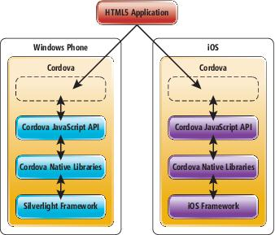
How does Cordova Work?

Slide 8


Supported Platforms?
Notes:
Android 2.3.3 and later (4.4 provides the best developer experience)
iOS 6, 7, and 8
Windows 8 and 8.1
Windows Phone 8 and 8.
Windows Universal

Slide 9





What do I need?
Notes:
This stuff is installed for you.

Slide 10
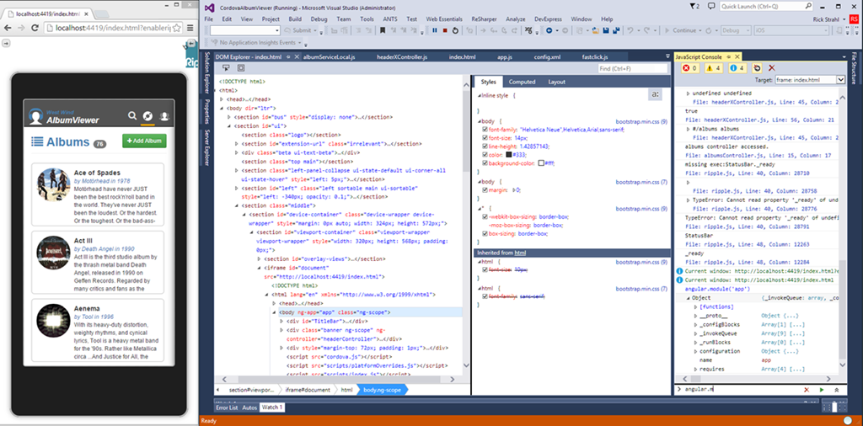
Emulator Options - Ripple

Slide 11
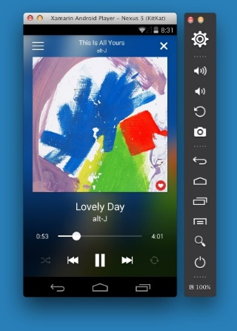
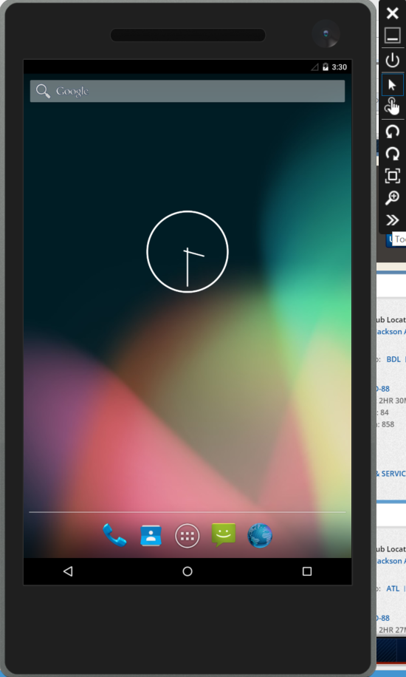
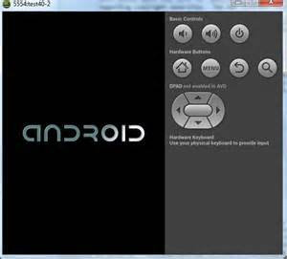
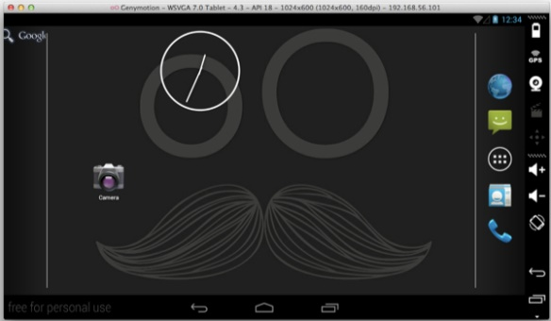
Emulator Options - Android

Slide 12
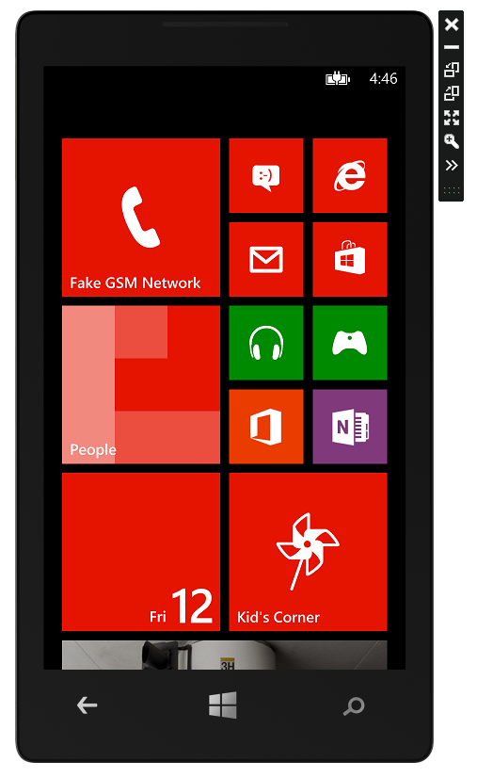
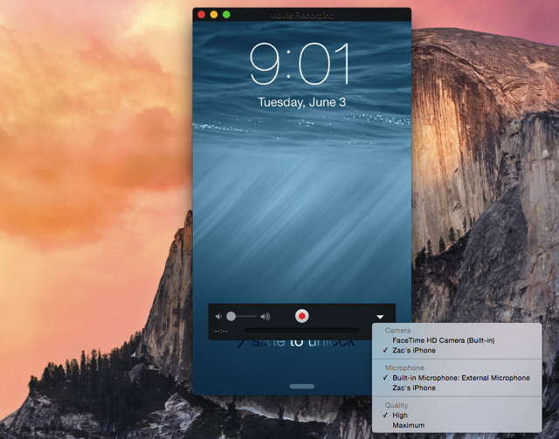
iOS and Windows Phone

Slide 13
Plugins
Listed in config.xml
Cross Platform API Access in JavaScript
Written in Native Languages (Objective-C, Java, C#)
Plugin Directory - http://cordova.apache.org/plugins/
Abstraction APIs Can Hide Native Features
Changes May Lag Latest Platform Changes

Slide 14
Libraries and Scripts

Slide 15








What about the UI?

Slide 16
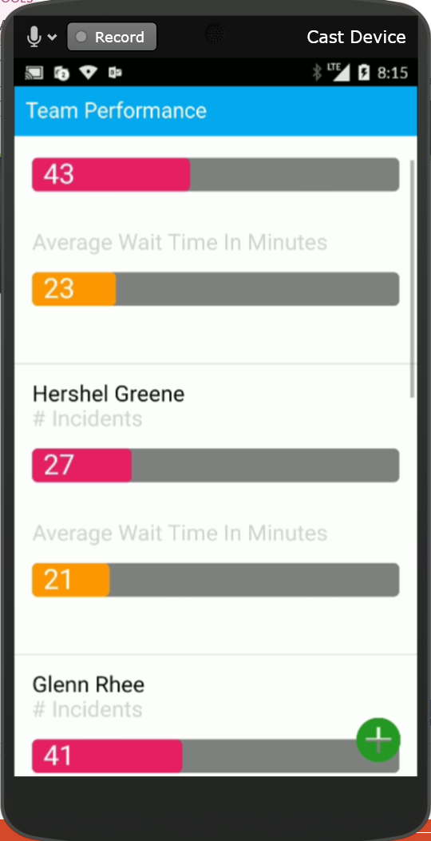
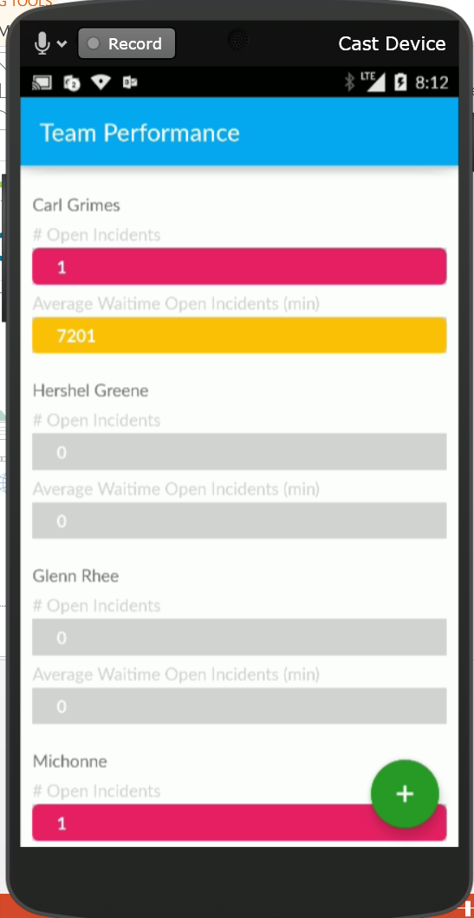
A Tale of Two Apps

Slide 17
Adding an UI Framework

Slide 18
About Ionic 2
Uses Angular 2
Styles UI
Extra Utilities
Ionic Lab
Live Reload
App Viewer

Slide 19
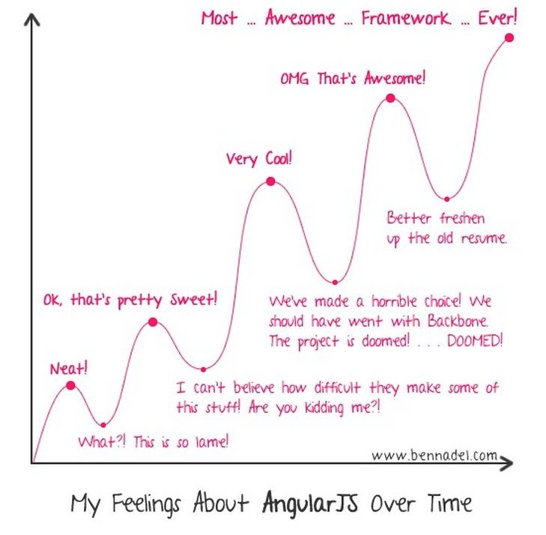
Angular Learning Curve

Slide 20
Angular – Single Page Application
Main Page
View 1
<html>
<script src="build/js/app.bundle.js"></script> <body>
<ion-app>
View 2
View 1
View 2
View 3
View 1
View 4
View 3
View 4
</ion-app>
</body>
</html>

Slide 21
Setting up Ionic
npm install –g cordova ionic
Ionic start <app name> <app type> --v2
App Types: blank, tabs, sidemenu, slide
To work in Visual Studio with TACO
https://taco.visualstudio.com/en-us/docs/interoperability/

Slide 22
Creating a Page
Basic Structure
Pages
<ion-content>
</ ion-content >
List
<ion-list>
<ion-item></ion-item>
</ion-list>

Slide 23
Binding
Create variables in controller using ‘this’
public registration: Registration;
Display: <ion-item>{{ registration.ScreenName }} </ion-item>
Edit: <ion-input data-ng-style="width: 50%" id="txtName" [(ngModel)] ="MyName" />

Slide 24
Validation/Formatting Syntax
Formatting
<ion-item>{{ Name | uppercase }}</ion-item>
<ion-item>{{ OtherName | lowercase }}</ion-item>
<ion-item>{{ SomeDate | date:'MM-dd-yyyy' }}</Ion-item>
Validation
<ion-input type="text" id="txtName" [(ngModel)] =“MyText" required />
<ion-input type="text" id="txtName" [(ngModel)] ="MyText" required="" minlength="4" maxlength="24" />
<ion-datetime required displayFormat="MM/DD/YYYY" id="txtDate" [(ngModel)] =“MyDate” />
Errors
<div [hidden]="!MyText.errors.minlength">
Text must be at least 4 characters long.
</div>
<div [hidden]="!MyText.errors.maxlength">
Text cannot be more than 24 characters long.
</div>

Slide 25
Connecting to Azure
Installed via Plugin
Asnyc done via callback (.done {} )
Table Result Format: result[record index][field name]
Json handling via GSon

Slide 26
Conclusion
Fastest way to Create X-Platform Apps
UI Compromises
Plugin Limitations – often lag behind changes
Can use Node.js for Unified Stack
Performance Compromises

Slide 27
Questions?

